Slide 1
Deutsche Bank
Complaint Analysis
Period : April 2024 to March 2025

Slide 2
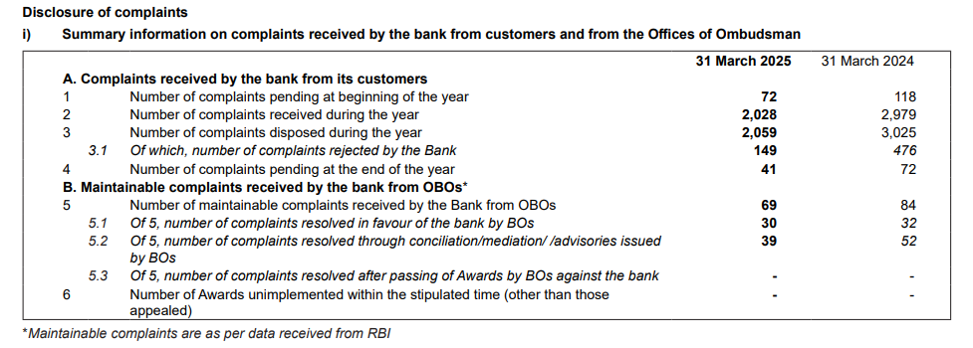
Complaints Summary

Slide 3
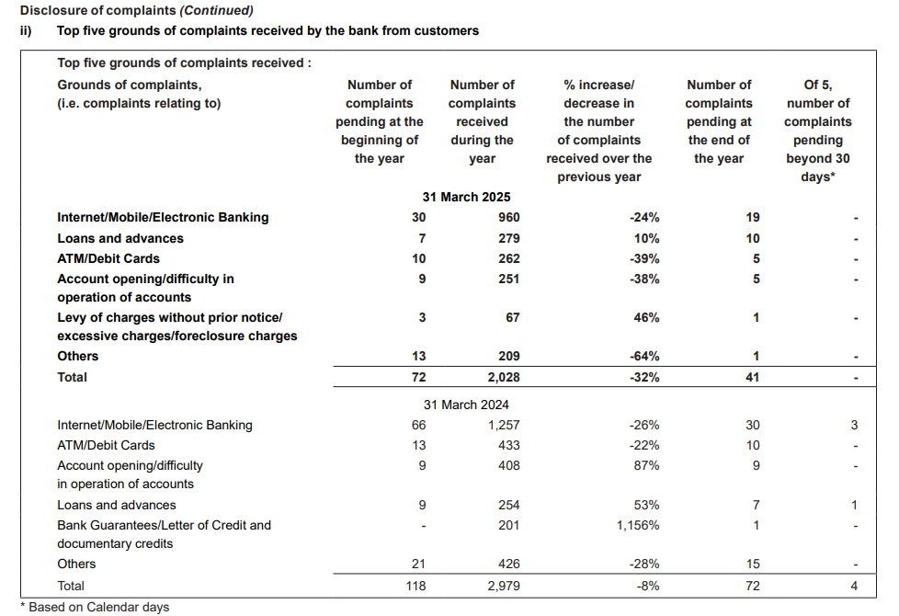
Complaints Summary

