Slide 1
Deutsche Bank
Complaint Analysis
Period : April 2021 to March 2022

Slide 2
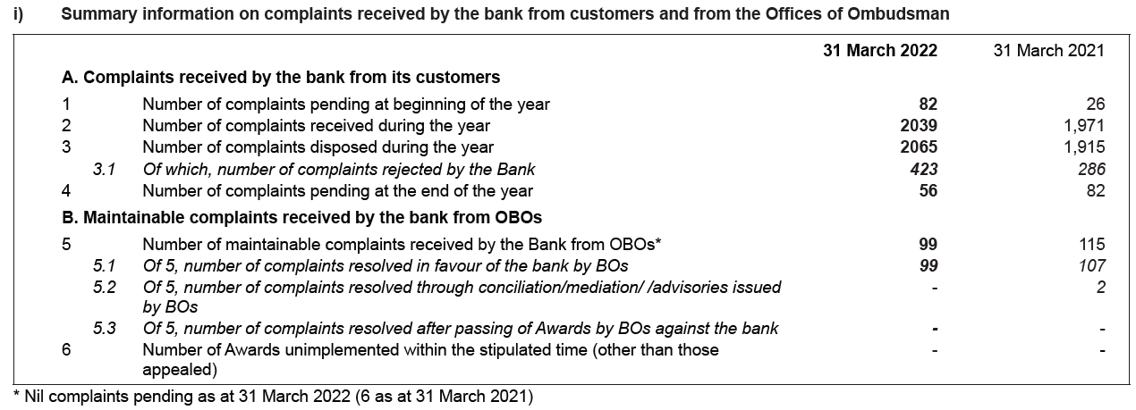
Complaints Summary

Slide 3
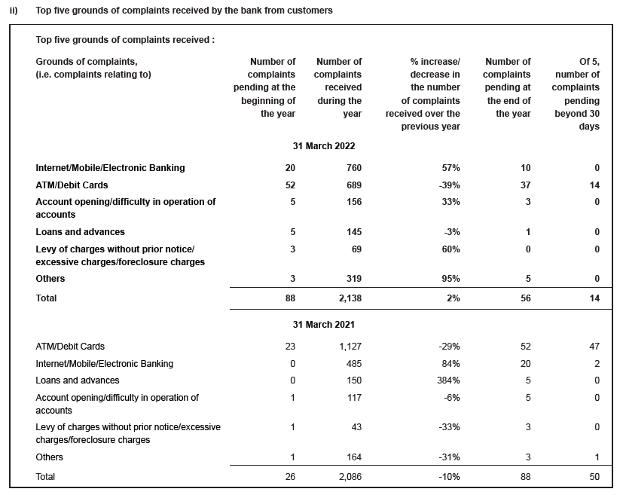
Complaints Summary
Letter of comfort
The Bank has not issued any letter of comfort during the year ended March 31, 2021 and March 31, 2020.
Provisioning Coverage Ratio as at 31 March 2021 is 68.87% (Previous year 55.75%)

